Slide 1
VISUAL REASONING
INSERT THE MISSING CHARACTER

Slide 2

VISUAL REASONING
INSERT THE MISSING CHARACTER
Q 1. Insert the missing character in place of question mark.
A.18 B.12 C.9 D.6

Slide 3
VISUAL REASONING
INSERT THE MISSING CHARACTER
Q 1. Insert the missing character in place of question mark.
A.18 B.12 C.9 D.6

Slide 4

VISUAL REASONING
INSERT THE MISSING CHARACTER
Q 2. Insert the missing character in place of question mark.
A.25 B.37 C.41 D.47

Slide 5
VISUAL REASONING
INSERT THE MISSING CHARACTER
Q 2. Insert the missing character in place of question mark.
A.25 B.37 C.41 D.47

Slide 6
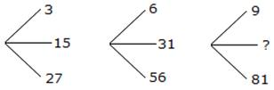
VISUAL REASONING
INSERT THE MISSING CHARACTER
Q 3. Insert the missing character in place of question mark.
A.45 B.41 C.32 D.40

Slide 7
VISUAL REASONING
INSERT THE MISSING CHARACTER
Q 3. Insert the missing character in place of question mark.
A.45 B.41 C.32 D.40

Slide 8

VISUAL REASONING
INSERT THE MISSING CHARACTER
Q 4. Insert the missing character in place of question mark.
A.115 B.130 C.135 D.140

Slide 9
VISUAL REASONING
INSERT THE MISSING CHARACTER
Q 4. Insert the missing character in place of question mark.
A.115 B.130 C.135 D.140

Slide 10

VISUAL REASONING
INSERT THE MISSING CHARACTER
Q 5. Insert the missing character in place of question mark.
A.92 B.72 C.62 D.99

Slide 11
VISUAL REASONING
INSERT THE MISSING CHARACTER
Q 5. Insert the missing character in place of question mark.
A.92 B.72 C.62 D.99

Slide 12
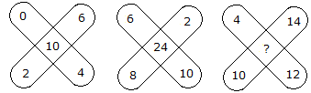
VISUAL REASONING
INSERT THE MISSING CHARACTER
Q 6. Insert the missing character in place of question mark.
A.36 B.48 C.38 D.30

Slide 13
VISUAL REASONING
INSERT THE MISSING CHARACTER
Q 6. Insert the missing character in place of question mark.
A.36 B.48 C.38 D.30

Slide 14

VISUAL REASONING
INSERT THE MISSING CHARACTER
Q 7. Insert the missing character in place of question mark.
A.41 B.64 C.35 D.61

Slide 15
VISUAL REASONING
INSERT THE MISSING CHARACTER
Q 7. Insert the missing character in place of question mark.
A.41 B.64 C.35 D.61

Slide 16
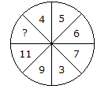
VISUAL REASONING
INSERT THE MISSING CHARACTER
Q 8. Insert the missing character in place of question mark.
A.13 B.14 C.12 D.15

Slide 17
VISUAL REASONING
INSERT THE MISSING CHARACTER
Q 8. Insert the missing character in place of question mark.
A.13 B.14 C.12 D.15

Slide 18
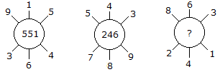
VISUAL REASONING
INSERT THE MISSING CHARACTER
Q 9. Insert the missing character in place of question mark.
A.262 B.622 C.631 D.824

Slide 19
VISUAL REASONING
INSERT THE MISSING CHARACTER
Q 9. Insert the missing character in place of question mark.
A.262 B.622 C.631 D.824

Slide 20
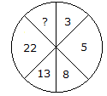
VISUAL REASONING
INSERT THE MISSING CHARACTER
Q 10. Insert the missing character in place of question mark.
A.45 B.29 C.39 D.37

Slide 21
VISUAL REASONING
INSERT THE MISSING CHARACTER
Q 10. Insert the missing character in place of question mark.
A.45 B.29 C.39 D.37

Slide 22

VISUAL REASONING
INSERT THE MISSING CHARACTER
Q 11. Insert the missing character in place of question mark.
A.184 B.210 C.241 D.425

Slide 23
VISUAL REASONING
INSERT THE MISSING CHARACTER
Q 11. Insert the missing character in place of question mark.
A.184 B.210 C.241 D.425

Slide 24

VISUAL REASONING
INSERT THE MISSING CHARACTER
Q 12. Insert the missing character in place of question mark.
A.0 B.2 C.11 D.12

Slide 25
VISUAL REASONING
INSERT THE MISSING CHARACTER
Q 12. Insert the missing character in place of question mark.
A.0 B.2 C.11 D.12

Slide 26

VISUAL REASONING
INSERT THE MISSING CHARACTER
Q 13. Insert the missing character in place of question mark.
A.64 B.144 C.169 D.25

Slide 27
VISUAL REASONING
INSERT THE MISSING CHARACTER
Q 13. Insert the missing character in place of question mark.
A.64 B.144 C.169 D.25

Slide 28
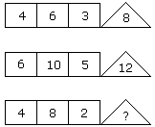
VISUAL REASONING
INSERT THE MISSING CHARACTER
Q 14. Insert the missing character in place of question mark.
A.8 B.12 C.16 D.20

Slide 29
VISUAL REASONING
INSERT THE MISSING CHARACTER
Q 14. Insert the missing character in place of question mark.
A.8 B.12 C.16 D.20

Slide 30
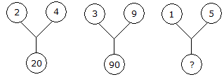
VISUAL REASONING
INSERT THE MISSING CHARACTER
Q 15. Insert the missing character in place of question mark.
A.75 B.26 C.25 D.20

Slide 31
VISUAL REASONING
INSERT THE MISSING CHARACTER
Q 15. Insert the missing character in place of question mark.
A.75 B.26 C.25 D.20

Slide 32

VISUAL REASONING
INSERT THE MISSING CHARACTER
Q 16. Insert the missing character in place of question mark.
A.11 B.14 C.10 D.12

Slide 33
VISUAL REASONING
INSERT THE MISSING CHARACTER
Q 16. Insert the missing character in place of question mark.
A.11 B.14 C.10 D.12

Slide 34
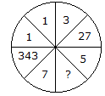
VISUAL REASONING
INSERT THE MISSING CHARACTER
Q 17. Insert the missing character in place of question mark.
A.25 B.625 C.125 D.50

Slide 35
VISUAL REASONING
INSERT THE MISSING CHARACTER
Q 17. Insert the missing character in place of question mark.
A.25 B.625 C.125 D.50

Slide 36

VISUAL REASONING
INSERT THE MISSING CHARACTER
Q 18. Insert the missing character in place of question mark.
A.30 B.13 C.70 D.118

Slide 37
VISUAL REASONING
INSERT THE MISSING CHARACTER
Q 18. Insert the missing character in place of question mark.
A.30 B.13 C.70 D.118

Slide 38

VISUAL REASONING
INSERT THE MISSING CHARACTER
Q 19. Insert the missing character in place of question mark.
A.40 B.38 C.44 D.39

Slide 39
VISUAL REASONING
INSERT THE MISSING CHARACTER
Q 19. Insert the missing character in place of question mark.
A.40 B.38 C.44 D.39

Slide 40

VISUAL REASONING
INSERT THE MISSING CHARACTER
Q 20. Insert the missing character in place of question mark.
A.60 B.46 C.86 D.75

Slide 41
VISUAL REASONING
INSERT THE MISSING CHARACTER
Q 20. Insert the missing character in place of question mark.
A.60 B.46 C.86 D.75

Slide 42
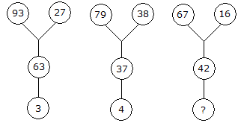
VISUAL REASONING
INSERT THE MISSING CHARACTER
Q 21. Insert the missing character in place of question mark.
A.5 B.6 C.8 D.9

Slide 43
VISUAL REASONING
INSERT THE MISSING CHARACTER
Q 21. Insert the missing character in place of question mark.
A.5 B.6 C.8 D.9

Slide 44
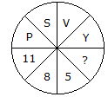
VISUAL REASONING
INSERT THE MISSING CHARACTER
Q 22. Insert the missing character in place of question mark.
A.3 B.2 C.7 D.6

Slide 45
VISUAL REASONING
INSERT THE MISSING CHARACTER
Q 22. Insert the missing character in place of question mark.
A.3 B.2 C.7 D.6

Slide 46

VISUAL REASONING
INSERT THE MISSING CHARACTER
Q 23. Insert the missing character in place of question mark.
A.8 B.32 C.4 D.16

Slide 47
VISUAL REASONING
INSERT THE MISSING CHARACTER
Q 23. Insert the missing character in place of question mark.
A.8 B.32 C.4 D.16

Slide 48
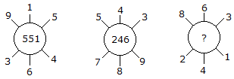
VISUAL REASONING
INSERT THE MISSING CHARACTER
Q 24. Insert the missing character in place of question mark.
A.262 B.622 C.631 D.824

Slide 49
VISUAL REASONING
INSERT THE MISSING CHARACTER
Q 24. Insert the missing character in place of question mark.
A.262 B.622 C.631 D.824

Slide 50

VISUAL REASONING
INSERT THE MISSING CHARACTER
Q 25. Insert the missing character in place of question mark.
A.20 B.26 C.25 D.75

Slide 51
VISUAL REASONING
INSERT THE MISSING CHARACTER
Q 25. Insert the missing character in place of question mark.
A.20 B.26 C.25 D.75

Slide 52
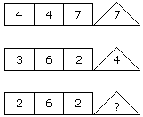
VISUAL REASONING
INSERT THE MISSING CHARACTER
Q 26. Insert the missing character in place of question mark.
A.2 B.4 C.6 D.8

Slide 53
VISUAL REASONING
INSERT THE MISSING CHARACTER
Q 26. Insert the missing character in place of question mark.
A.2 B.4 C.6 D.8

Slide 54

VISUAL REASONING
INSERT THE MISSING CHARACTER
Q 27. Insert the missing character in place of question mark.
A.14 B.22 C.32 D.320

Slide 55
VISUAL REASONING
INSERT THE MISSING CHARACTER
Q 27. Insert the missing character in place of question mark.
A.14 B.22 C.32 D.320

Slide 56

VISUAL REASONING
INSERT THE MISSING CHARACTER
Q 28. Insert the missing character in place of question mark.
A.18 B.90 C.108 D.28

Slide 57
VISUAL REASONING
INSERT THE MISSING CHARACTER
Q 28. Insert the missing character in place of question mark.
A.18 B.90 C.108 D.28

Slide 58
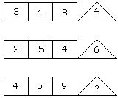
VISUAL REASONING
INSERT THE MISSING CHARACTER
Q 29. Insert the missing character in place of question mark.
A.8 B. 9 C. 10 D.11

Slide 59
VISUAL REASONING
INSERT THE MISSING CHARACTER
Q 29. Insert the missing character in place of question mark.
A.8 B. 9 C. 10 D.11

